Slide 1
Image Text Detection App

Slide 2
HOME
ABOUT
CONTACT
IMAGE
TEXT OUTPUT FROM IMAGE
(SYSTEM GENERATED)
UPLOAD
FILEPATH
Initial Draft Design of Landing Page
GET TEXT FROM IMAGE

Slide 3
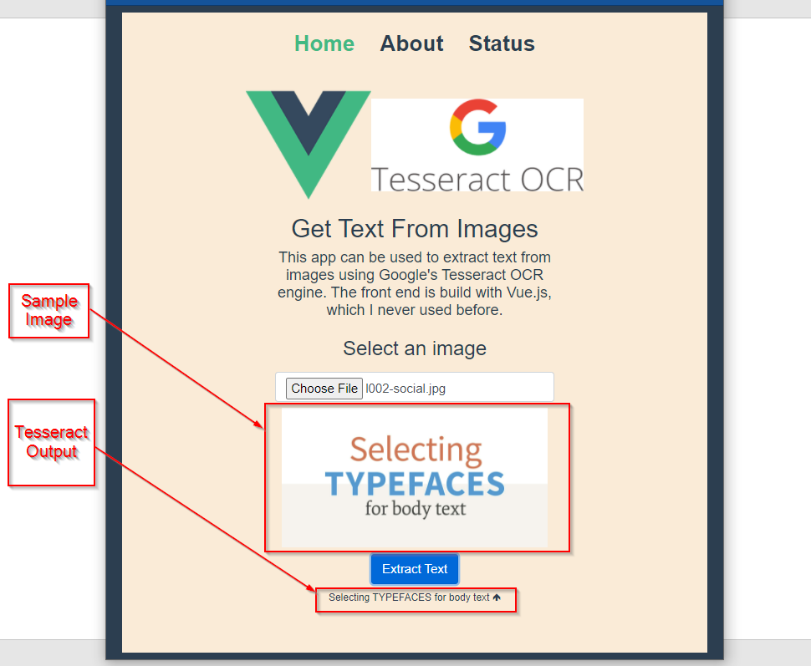
Actual Landing Page with Release 1.0

Slide 4




Network Traffic Flow
(Development)
Proxies API Calls (Port 5000)
Access Website on Port 80
Serve Website (Port 80)
Call API (Port 80) for Text Extraction

